Slide 1
Hypothesis Testing

Slide 2
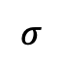
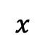
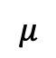
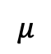

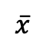
Population A
$$σ$$
$$μ$$
$$x$$
Sample means
$$\frac{σ}{\sqrt{n}}$$
Sample of size n
$$μ$$
$$\overline{x}$$

Slide 3
Population A
Population ???
$$σ$$
$$μ$$
$$x$$
Does this sample come from population A or not?
Sample means
$$\frac{σ}{\sqrt{n}}$$
?
Sample of size n
Sample of size n
$$μ$$
$$\overline{x}$$
Three hypothetical outcomes for mean of sample from population ???

Slide 4
Population A
Population ???
$$σ$$
$$μ$$
$$x$$
Does this sample come from population A or not?
Sample means
$$\frac{σ}{\sqrt{n}}$$
?
Sample of size n
Sample of size n
$$μ$$
$$\overline{x}$$
?
Yes
No

Slide 5
Distribution of scores in a recall task for subjects given a placebo
Assume we know this from prior experiment.
Distribution of scores in a recall task for subjects given an experimental drug
$$σ$$
$$μ$$
$$x$$
Does the drug affect mean recall?
Sample mean
$$\frac{σ}{\sqrt{n}}$$
?
50 subjects
50 subjects
$$μ$$
$$\overline{x}$$
Hypothetical mean recall scores for subjects given the drug
?
No
Yes

Slide 7
Distribution of scores in a recall task for subjects given a placebo
Assume we know this from prior experiment.
Distribution of scores in a recall task for subjects given an experimental drug
$$σ$$
Null Hypothesis H₀: Drug has no effect
Alternative Hypothesis H_{a}: Drug has an effect
$$μ$$
$$x$$
Does the drug affect mean recall?
Sample mean
$$\frac{σ}{\sqrt{n}}$$
?
50 subjects
50 subjects
$$μ$$
$$\overline{x}$$
Hypothetical mean recall scores for subjects given the drug
?
Don’t Reject H₀
Reject H₀

Slide 11
!!! p-value calculations assume that the null hypothesis is correct.
Thus, from the p-value’s point of view, the null hypothesis is 100% true.
p-values assume that the null is true and the observed sample effect is caused by random sample error.
p-values tell you how consistent your sample data are with a null hypothesis that is true.
However, when your data are very inconsistent with the null hypothesis, p-values can’t determine which of the following two possibilities is more probable:
The null hypothesis is true, but your sample is unusual due to random sample error.
The null hypothesis is false.

Slide 12
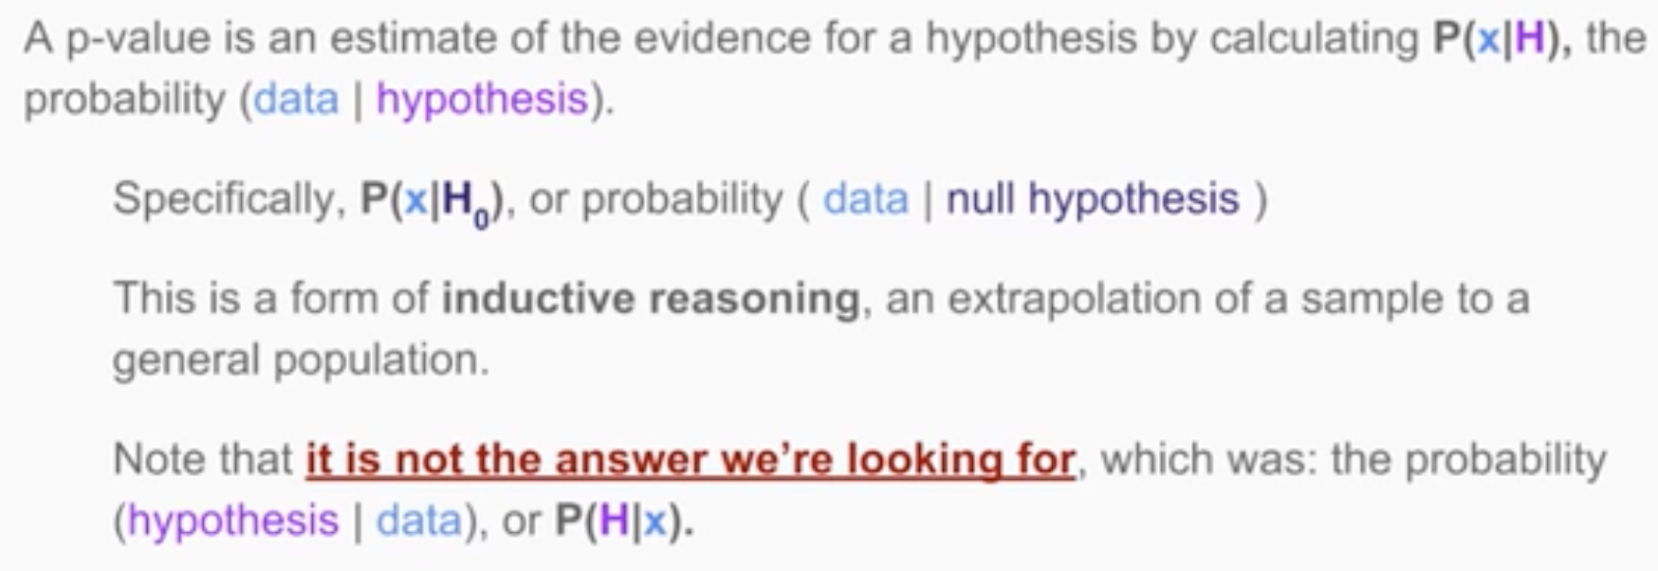

Slide 13
H₀
H_{a}

Slide 14
Type II Error
H₀ was false, but we didn’t reject it
Type I Error
H₀ was true, but we rejected it
H₀
H_{a}

Slide 15
Type II Error
H₀ was false, but we didn’t reject it
1 – β = Power
Probability that we actually reject H₀ when it is false
Type I Error
H₀ was true, but we rejected it
H₀
H_{a}

Slide 16
Power = 0.5
!!! Only 50% chance of detecting a real difference.
p = 0.049

Slide 17
Small samples from populations A & B:
Low power
Large samples from same populations A & B:
High power

Slide 18
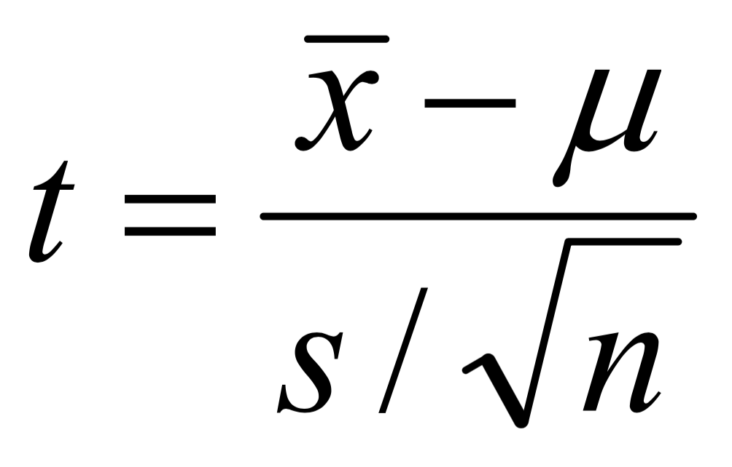
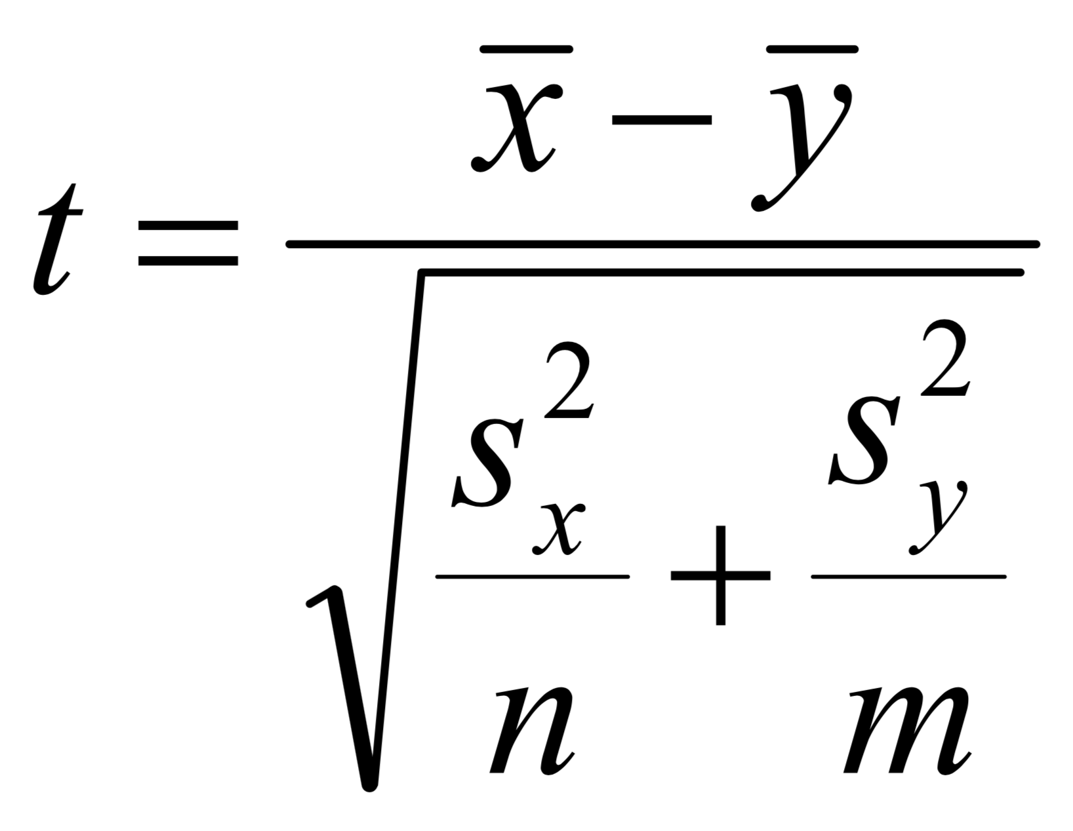

Slide 19
Types of t-Tests:
Does a single sample come from a known population with mean value μ?
H₀: Sample comes from population with known mean μ.
H_{a}: Sample does NOT come from population with known mean μ.
Do two independent samples come from the same distribution?
H₀: Samples come from the same distribution.
H_{a}: Samples do NOT come from the same distribution.
Do two related samples come from the same distribution?
H₀: Samples come from the same distribution.
H_{a}: Samples do NOT come from the same distribution.

Slide 20
State the null and alternative hypotheses.
Select an appropriate test statistic and a cutoff (e.g. α = 0.05).
Determine the sample size required for a given power (e.g. 1 – β = 0.8)
Compute a p-value.
Decide whether or not to reject the null hypothesis.
If the null hypothesis is rejected, determine whether the effect size is important or not.

